Slide 1
Date: 23 December 2025

Slide 2
Weekly Presentation : Rotor Bearing System
Week number: 13
Date: 16 /12/2025
Supervisor: Prof. Peter Quell
Group members: Divyesh Mistry, Venkata Sreekanth .K , Sreehari Padachery, Jill Sadariya
Presenter : Sreehari Padachery

Slide 3
Agenda
Shaft.
Rotor Lock Disc.
Bearing Housing.
Rotor Lock Pin.
Labyrinth seal.
Lock nut.
Rotor Bearing Assembly.
Fatigue calculation.
Bibliography.
Sreehari Padachery

Slide 4
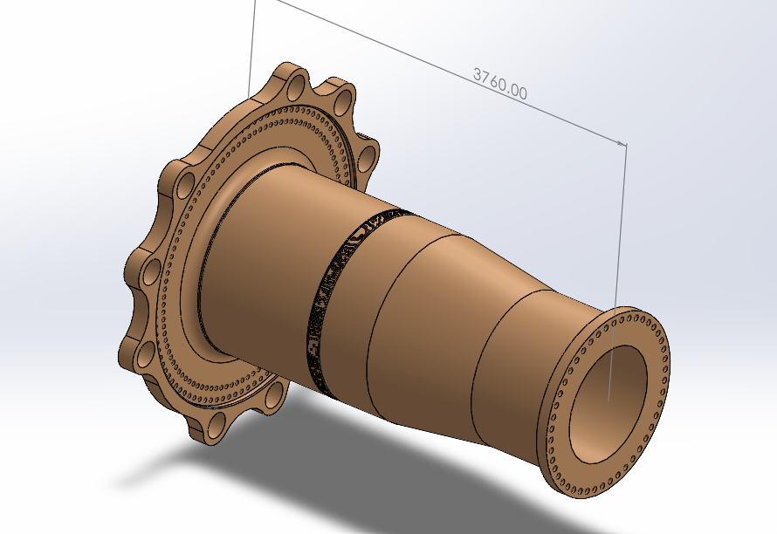
Rotor Shaft
Hub Side Flange
Description | Symbol | Value | Unit
Outer screw circle diameter | dt2 | 2450 | mm
Inner screw circle diameter | dt1 | 2250 | mm
No. of screws per bolt circle diameter | N_{total} = N_{ICB} + N_{OCB} | 94+102=196
Integrated rotorlock Flange outer dia | D_{flange} | 3190 | mm
Integrated Flange Thickness | _{t} | 200 | mm
Gear box Side Flange
Description | Symbol | Value | Unit
screw circle diameter | dt1 | 1464 | mm
No. of screws per bolt circle diameter | N_{total} | 46
Flange outer dia | D_{flange} | 1584 | mm
(Own Design)
Sreehari Padachery

Slide 5
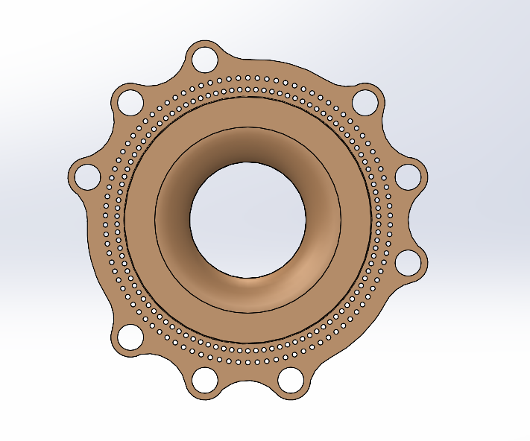
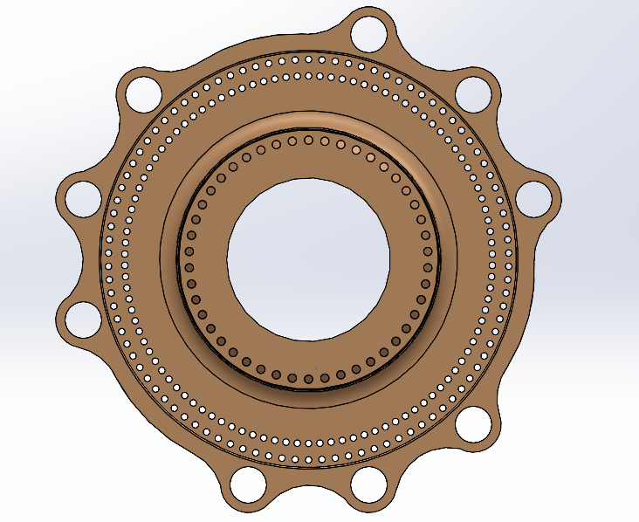
Rotor Lock Disc
Removed the parts without holes
(Own Design)
Sreehari Padachery

Slide 6
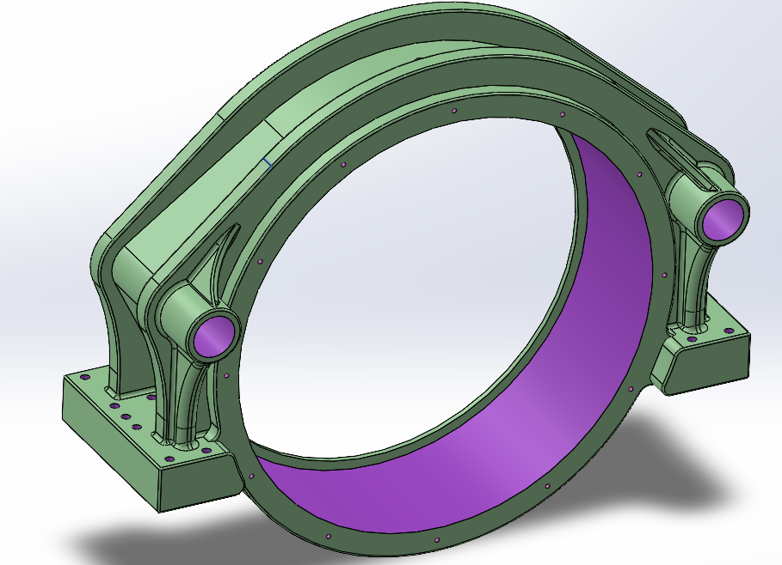
Bearing Housing
parameter | value | unit
OD | 2500 | mm
ID/Bore dia | 2240 | mm
Width | 720 | mm
Total lenght | 3200 | mm
Rib Radius | 1400 | mm
Length of the Legs | 1000 | mm
(Own Design)
Sreehari Padachery

Slide 7
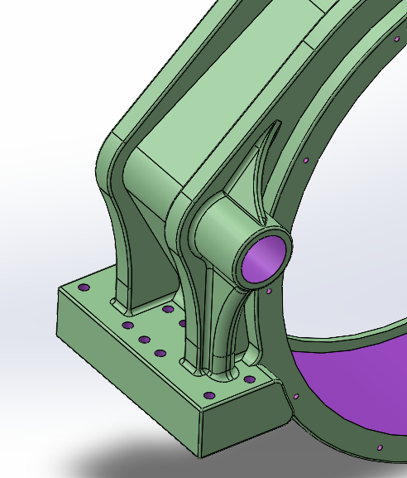
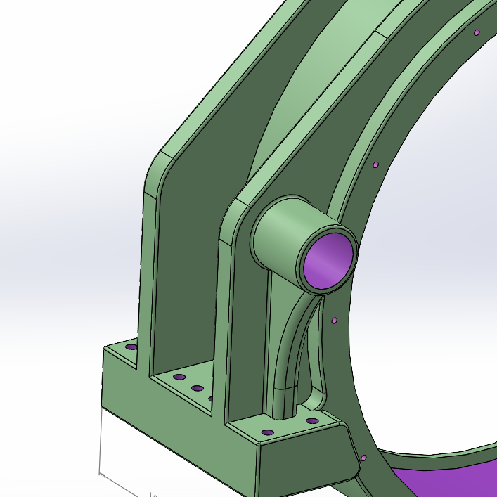
Changed the rib design to curve
Sreehari Padachery

Slide 8
Extended the lock pin hole structure until next rib
E
Sreehari Padachery

Slide 9
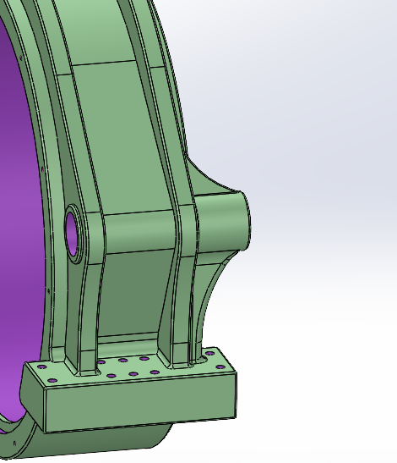
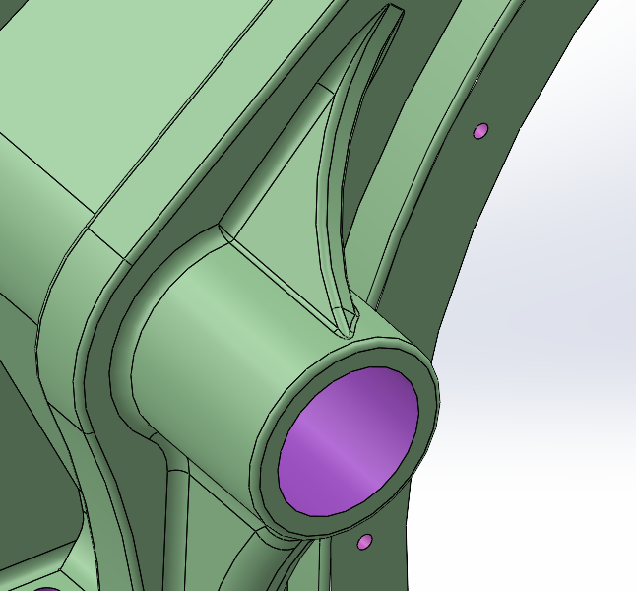
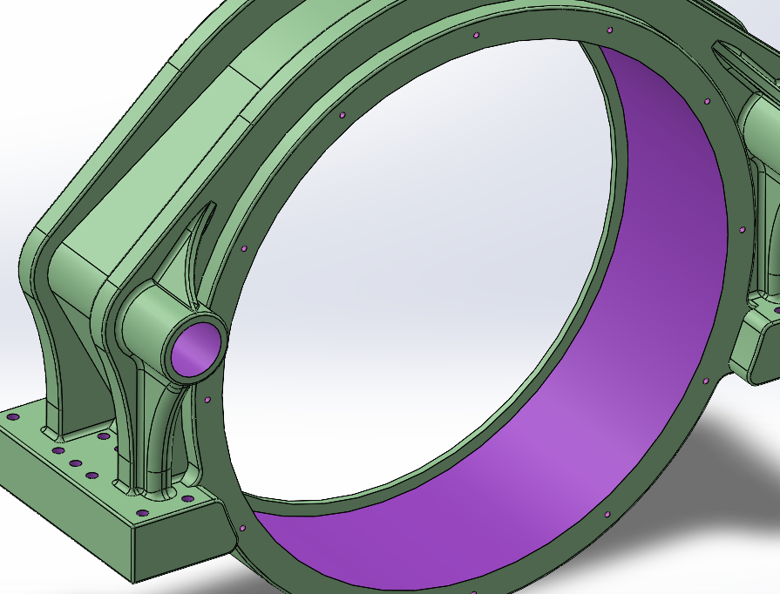
Support added
Sreehari Padachery

Slide 10
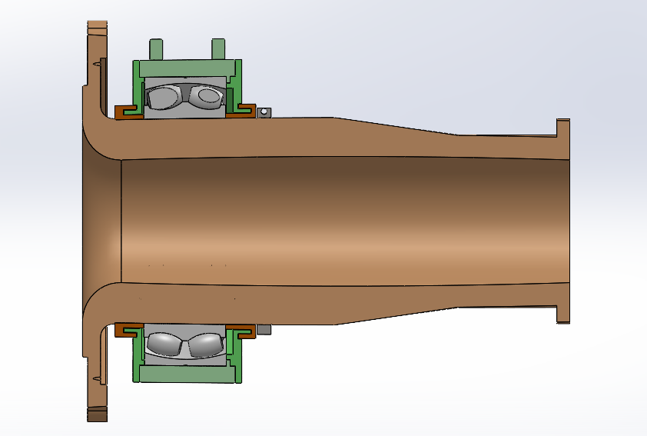
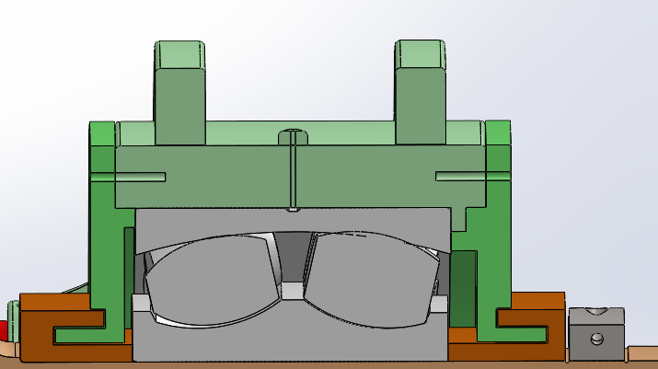
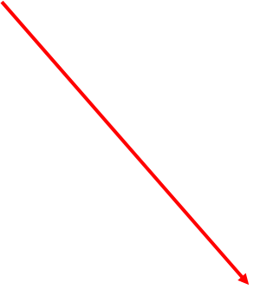
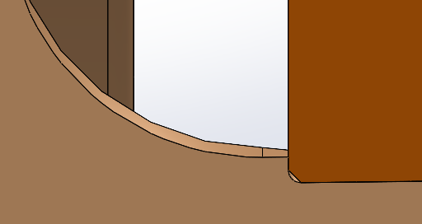
Labyrinth seal
Rotating Labyrinth seal
Chamfer
Fixed Labyrinth seal
(Own Design)
Sreehari Padachery

Slide 11
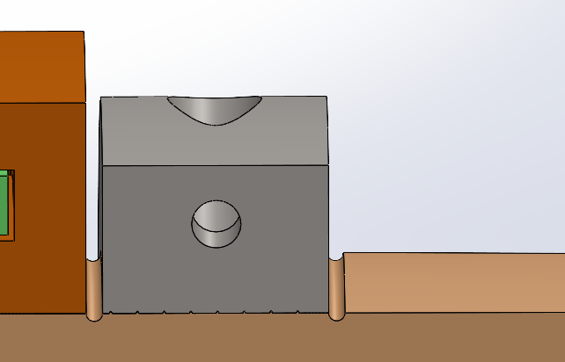
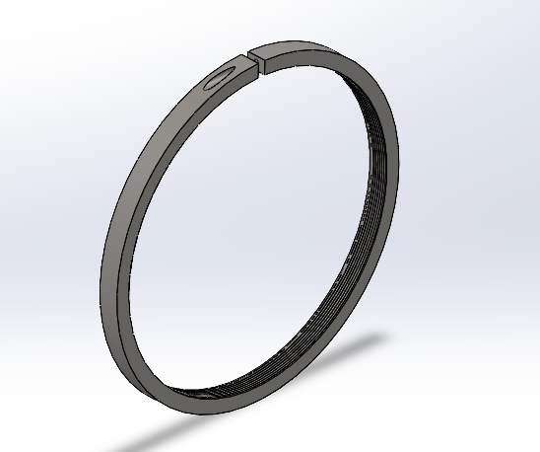
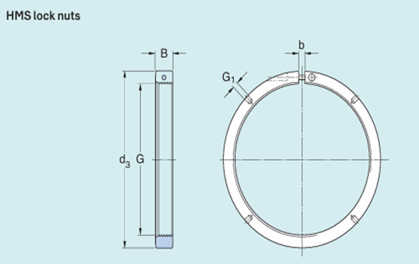
Lock Nut
Thread | Outer diameter | Width | Gap width | Thread for mounting lever
G | d3​ | B | b | G1​
Tr 1600x 8 | 1750 | 110 | 40 | M24
DOUBT
Do we need to consider this notch for lock nut
(Own Design)
Sreehari Padachery
Source: SKF

Slide 12
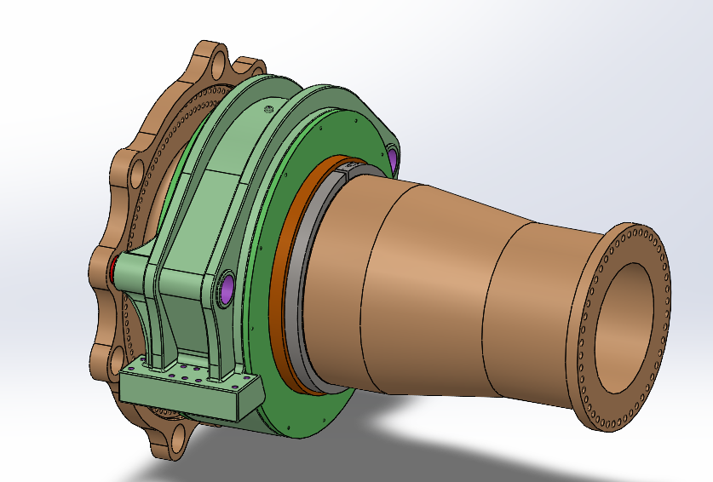
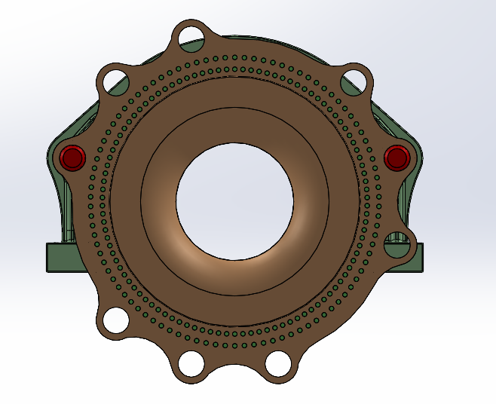
Rotor Bearing Assembly
(Own Design)
Sreehari Padachery

Slide 13
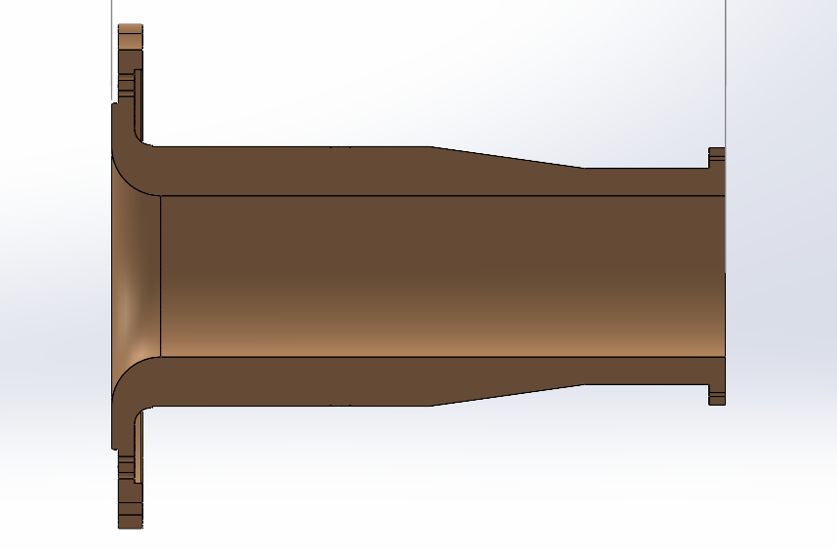
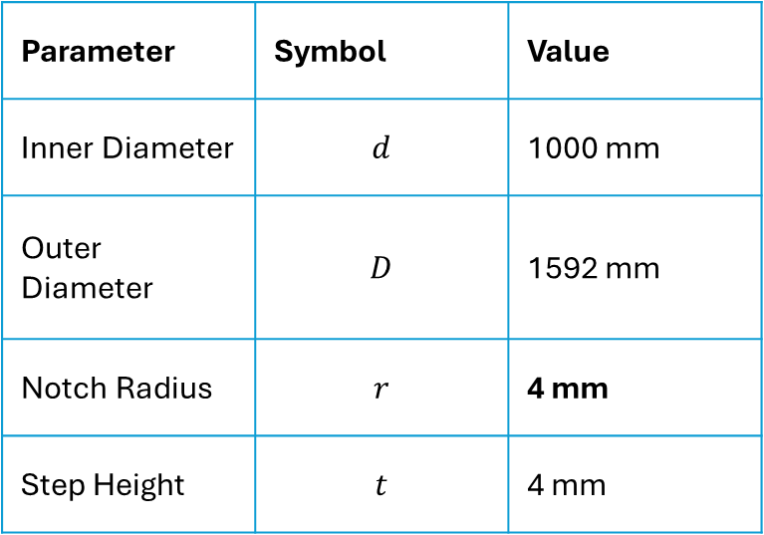
Fatigue calculation
Material
Load
Resultant Moment: 25,658 kNm
GJS-600 (Cast Iron)
Yield (Re): 370 MPa
Fatigue Limit: 190 MPa
Safety Factors
Material (γM): 1.2
Fatigue (j_{D}): 1.56 (General safety factor, FKM, Table 4.5.1)
Parameter | Symbol | Value
Inner Diameter | $$d$$ | 1000 mm
Outer Diameter | $$D$$ | 1592 mm
Notch Radius | $$r$$ | 4 mm
Step Height | $$t$$ | 4 mm
1000mm
1334mm
1600 mm
3760mm
Sreehari Padachery
Source: Optimus Shakti

Slide 14

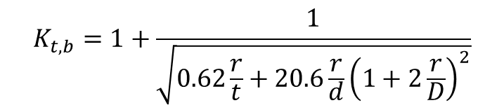

Governing Notch: Locknut Groove
The section modulus W is calculated for the hollow shaft at the critical groove diameter.
$$W=\frac{π}{32}⋅\frac{D^{4}−d^{4}}{D}$$
For D=1.592m and d=1.000m
$$W=0.322{\text{m}}^{3}$$
$$K_{t,b}=1+\frac{1}{\sqrt{0.62\frac{r}{t}+20.6\frac{r}{d}{\left(1+2\frac{r}{D}\right)}^{2}}}$$
Stress Concentration Factor ( $K_{t,b}$)
= 2.05
ULS Verification
$$σ_{ULS}=σ_{nom}⋅K_{tb}$$
$$σ_{nom}=\frac{M_{res}}{W}=\frac{25658}{0.322}=79.7\text{MPa}$$
$$=163.5\text{MPa}$$
Nominal Stress
σallow = Re,N /γM = 370/1.2=308Mpa
163.5 MPa (Actual) < 308.3 MPa (Allowable)
Sreehari Padachery

Slide 15
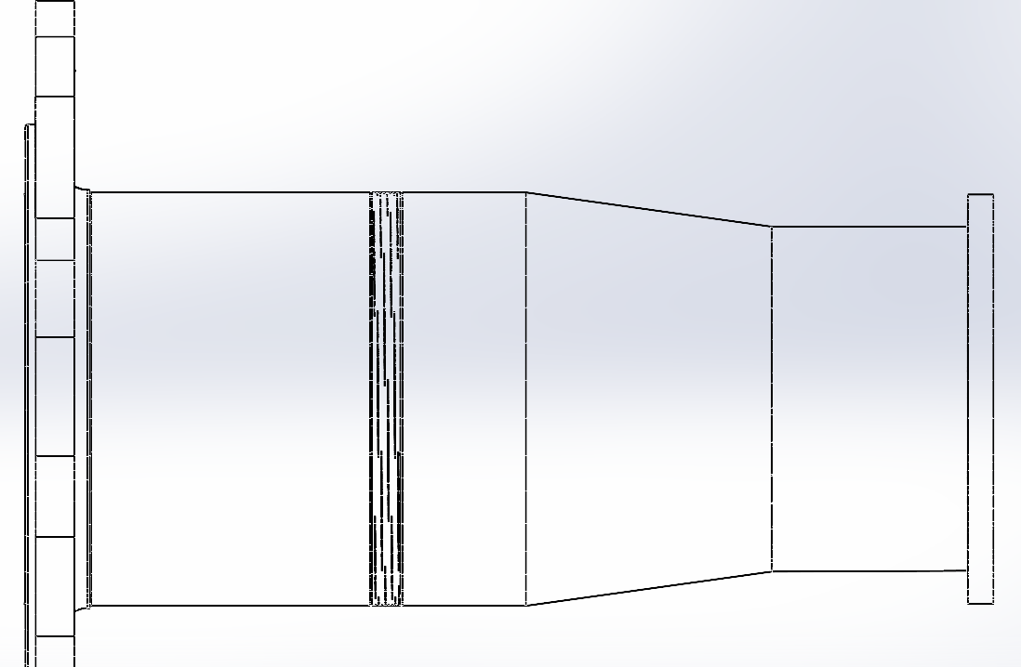
All three shaft notches were identified and evaluated according to the FKM guideline. The locknut groove was selected as the governing notch due to its smaller diameter and higher stress concentration
Notch1
Notch 2&3
Sreehari Padachery

Slide 16
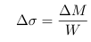
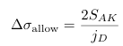
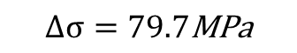
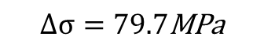

Fatigue Assessment
Stress Range
$$Δσ=79.7\text{MPa}$$
Based on support factor n=2.3
Notch Factor (Kf)=1.63
Size Factor (Kdm)
$$K_{d,m}=0.86$$
(For wall thickness 592mm)
Surface Roughness Factor $K_{R}=0.92$
AllowableStressRange
=121.9MPa
Fatigue Stress Limit
$$S_{AK}=K_{AK}⋅K_{d,m}⋅\frac{σ_{w,Zd,N}}{K_{f}+\frac{1}{K_{R}}−1}$$
=95.1MPa
FatigueVerification
$$Δσ=79.7\text{MPa}$$
< $Δσallowble$ (121.9MPa)
Sreehari Padachery
Source: Optimus Shakti

Slide 17
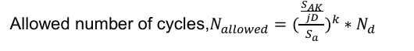
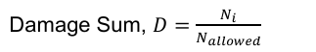
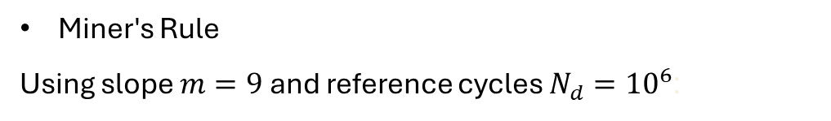

Fatigue Damage Calculation
Miner's Rule
Using slope $m=9$ and reference cycles $N_{d}={10}^{6}$:
$$D=\frac{{10}^{6}}{{\left(\frac{61.0}{39.85}\right)}^{9}⋅{10}^{6}}$$
=0.21
Total Damage=0.21
Total Damage=0.21 < 1
The shaft is SAFE against Ultimate Limit State (47% margin).
The shaft is SAFE against Fatigue (Damage = 0.21)
Sreehari Padachery
Source: Optimus Shakti

Slide 18
Bibliography – Rotor Bearing System
Optimus Shakti, Optimus 60E
DIN EN 10083-3: Steels for quenching and tempering – Part 3: Technical delivery conditions for alloy steels. Retrieved November 22, 2025, from https://studylib.net/doc/18166049/din-en-10083-steel-for-quenching-and-tempering-part-3-
American Institute of Steel Construction. (1989). Manual of Steel Construction: Allowable Stress Design (9th ed.). Chicago, IL: Author. Retrieved November 22, 2025, from Internet Archive (Manual of Steel Construction: Allowable Stress Design, 9th Edition)
LLM(Large Language Models).
Germanischer Lloyd Industrial Services GmbH, Renewables Certification. (2010). Guideline for the certification of wind turbines.
M. Wilhelmsen A/S. (n.d.). STEEL BOLT M48X240 10.9 DIN 931. Abgerufen am 8. Dezember 2025, von https://ehandel.mw.dk/en/steel-bolts-din-931/steel-bolt-m48-109
FKM guidelines.
Sreehari Padachery

